Slide 1
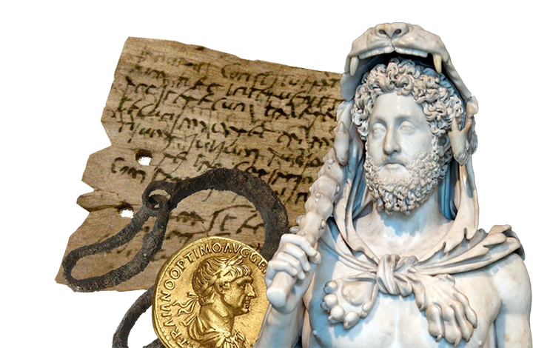
In the Emperors and Empires project, we will learn about the growth and decline of the Roman Republic and the Roman Empire. We will discover the absolute power of the Roman emperors and study the hierarchies of Roman society and the Roman army. We will study the first invasions of Britain in 55 and 54 BC and the Roman conquest of Britain in AD 43.
We will learn about Boudicca’s rebellion,
Hadrian’s Wall and the Romanisation of Britain, including how Christianity came to Britain and investigate the legacy of Roman Britain in our local area.
Emperors and Empires

Slide 2
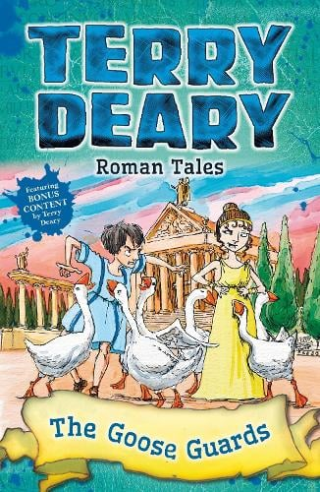
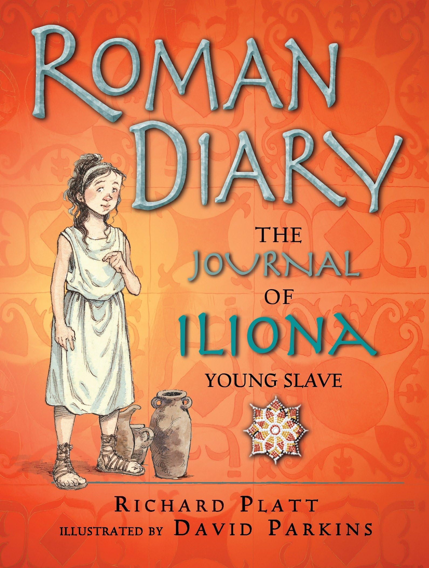

This term, our whole class reading book
is ‘Roman Tales: The Goose Guards’
by Terry Deary.
Roman Tales: The Goose Guards by Terry Deary is a fun and lively historical adventure that takes us back to ancient Rome. In this exciting story, we'll meet a brave group of geese who become the unlikely heroes protecting a vital secret at the Roman Emperor’s palace. With plenty of humour, mystery, and fascinating facts about Roman life, this book will transport us to a time of grand feasts, daring missions, and clever animals on a mission…
During this project we will also be looking at….

